Slide 1
Fib-Free Plymouth
If you can’t trust their facts You shouldn’t pass their Bylaw
Exposing misinformation, unsubstantiated statements, and factual distortions that support a Fur Free Plymouth proposed bylaw which prohibits the sale of fur in Plymouth

Slide 2
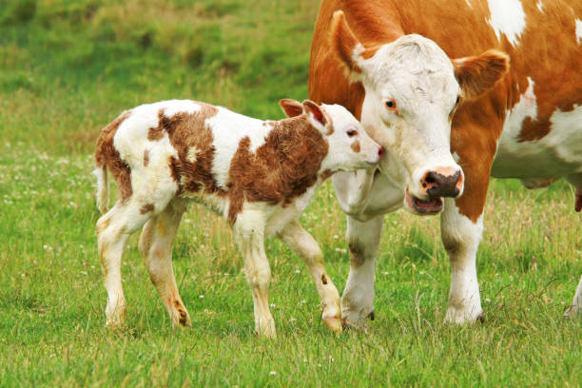
We all agree that a baby fox is cute but so is a baby cow!
Animal Cruelty is not only immoral, It’s illegal & Universally Condemned

Slide 3
What Justifies a Fur-Free Bylaw?
Most reasonable people believe that it is morally acceptable to use animals for food and other purposes provided species are not depleted (sustainability) and the animals are raised and killed with as little suffering as possible (animal welfare).
Both wild and farmed furs are now produced at least as responsibly and sustainably as other animals we use for food, leather and other purposes. *
Massachusetts is currently ranked the 6th best state for animal welfare laws.

Slide 4
Scope of Plymouth’s Proposed Fur-Free Bylaw
Fur Free Plymouth “In Brief the bylaw does not seak to limit the sale of wool, cashmere, leather, or any other cowhide or sheepskin with hair fibers still attached.”
“The bylaw is narrowly defined so as to prohibit only the sale of products that require animals to be raised/trapped and killed only for their fur pelts”
Peter Singer, the intellectual godfather of the Animal Rights movement, wrote that it is hypocritical to criticize fur-wearing while most people are still eating meat, which requires the killing of far greater numbers of animals.
Fact: In addition to fur, mink provide fat that is rendered to produce mink oil, used to waterproof and preserve leathers, as a fine lubricant and also in the manufacturing of hypo-allergenic facial oils and cosmetic
Manure, bedding (straw, shavings) and carcasses are used to produce organic fertilizers to replenish the soil.
They are now also being used to produce bio-fuels.

Slide 5
Unsubstantiated Statements
Fur Free Plymouth “ Animals are denied basic veterinary care” “Animals display neurotic, self harming behaviors from confinement”
Fact: Standards for pen sizes and handling farmed mink are developed by veterinarians, animal scientists, and animal-welfare authorities because it’s the ethical thing to do and it produces high-quality fur.

Slide 6
Distortion and Misinformation
Fur Free Plymouth “Animals are killed by the cheapest (and therefore slowest and most painful) means possible”
Fact: Farmed mink are generally euthanized with bottled carbon monoxide gas. A mobile unit is brought into the barn and wheeled from pen to pen, minimizing the stress of handling. The mink are placed into air-tight, gas-filled containers, rendered unconscious and die quickly and humanely.

Slide 7
Simply False Statements
Fur Free Plymouth “Animals can be trapped for days without food or water, sometimes dying of starvation or dehydration while trapped”
Fact: Massachusetts Trapping Regulations require the trapper to “visit all traps staked out, set, used, tended, placed, or maintained, and remove all animals trapped at least once in each calendar day”

Slide 8
Misinformation
Fur Free Plymouth “Trapped animals sometimes chew through their own legs to return to their cubs or packs, only to die Later of infection or blood loss” Photo used shows a “Fox with maimed leg in a steel leg hold trap”
Fact: Massachusetts Banned Leg Hold Traps in 1997

Slide 9
Fabricated Stories
Fur Free Plymouth “Animals still sometimes conscious when skinned”
l
Fact: Various photos & videos of “live skinning” on a Chinese fur farm have been staged by animal rights fanatics.
Why It’s Ridiculous to Claim Animals are Skinned Alive
1. It would be completely inhumane
2. It would be dangerous for the operator
3. It would take longer and be less efficient
4. It would spoil the fur
5. It’s illegal

Slide 10
Fear Mongering Covid-19
Fur Free Plymouth “mink on hundreds of fur farms…tested positive for SARS-CoV-2”
Fact: Strict bio-security measures exist on all North American mink farms. According to the Centers for Disease Control and Prevention “Currently, there is no evidence that mink are playing a significant role in the spread of SARS-CoV-2 to people.”

Slide 11
Unproven Statements Disguised as Fact
Fur Free Plymouth “fur farms worldwide are consistently reported to violate environmemntal regulations”
Fact: Fur farms are inspected and certified to ensure compliance with codes of practice developed by veterinarians and animal scientists. There is no credible evidence or local examples that fur animals are treated less respectfully than other animals that are used for food or clothing.

Slide 12
Wildlife Population Control
Overpopulated beavers flood homes, farms and roads; raccoons and foxes spread rabies, Lyme and other diseases; coyotes now attack pets and even people in urban areas; predators must be managed to protect other species.
If we must cull some of these animals, it’s more ethical to use the fur than to throw it away.
Trapping in North America is renewable & regulated by state wildlife agencies, in accordance with ISO standards and the Agreement on International Humane Trapping Standards.

Slide 13
Respecting Choice
No one is forced to wear fur. Everyone should be concerned about this misguided proposal to take away the right of Plymouth residents to make personal fashion choices.

Slide 14
Real Facts & Sources
https://en.wikipedia.org/wiki/Agreement_on_International_Humane_Trapping_Standards#Objectives_of_the_Agreement_on_International_Humane_Trapping_Standards
http://web.archive.org/web/20150905140550/http://furcommission.com/faq/#Anchor-44867
https://blog.truthaboutfur.com/indigenous-fur-harvesters-speak-out-against-anti-fur-campaigners/
https://www.mass.gov/service-details/trapping-information
Massachusetts ranked 6th best state in Animal Protection Laws https://aldf.org/project/us-state-rankings/
https://furcommissionx.wpengine.com/anti-fur-activists-use-faked-video-the-iff-investigates/

Slide 15
The Fur Free Plymouth relies on distorted facts to support a proposed bylaw at the 2022 April annual town meeting which prohibits the sale of fur in Plymouth
If you can’t trust their facts You shouldn’t pass their Bylaw

